Slide 1


MonkeyLingo
Presented by Mankirat Singh Sarwara & Christian Kfoury
May 8, 2002

Slide 2
Outline
Web Service Description
Idea and workflow Description
Implementation Description (code architecture, processing logic, used frameworks)
List of Entry Points
API Client Description
Program Features and Screenshots
Team Responsibilities
Challenges
Learning outcomes

Slide 3
What was this project about?
Our tasks were to implement
A webservice
An authorization controller
A client-server communication
CDN communication
Build a website using the MonkeyLingo web service.

Slide 4
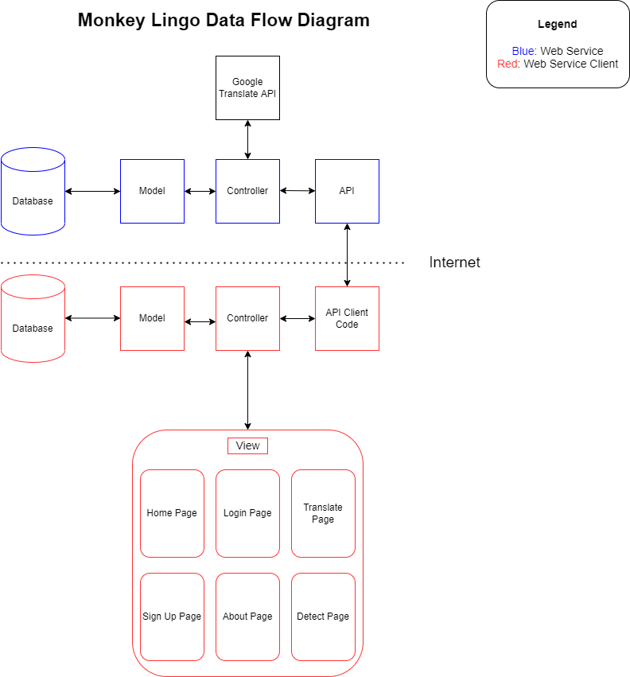
The idea & workflow description
Client-server communication
Authentication with API key or JWT token

Slide 5
Implementation description
Code architecture: Controller, model & database for each application (client & web service).
There is also a controller for the authentication part of the webservice.
Processing logic: User submits form to the translate or detect language page and the client then makes a request to the MonkeyLingo authentication & API. Then, the webservice processes the request by validating the client and makes a subsequent request to the Google Translate API and returns the response in JSON.
Frameworks used: none
Libraries: Guzzle, OpenAPI, JWT, cURL, Logger, AWS

Slide 6
List of entry points
http://localhost/webservice/detect
http://localhost/webservice/translate
http://localhost/webservice/getlanguages
http://localhost/authcontroller/auth

Slide 7
API Client
It has its own:
Database
Controller
Model
Views
For controlling the workflow of the user and handling reponses from the MonkeyLingo API.

Slide 8
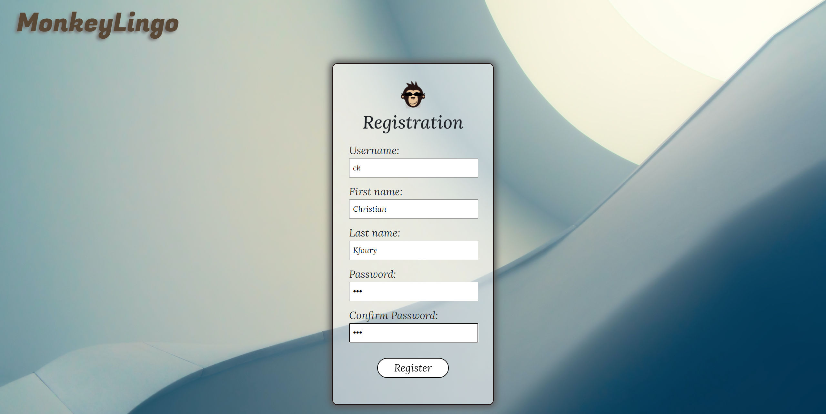
Program Feature & screenshots

Slide 9
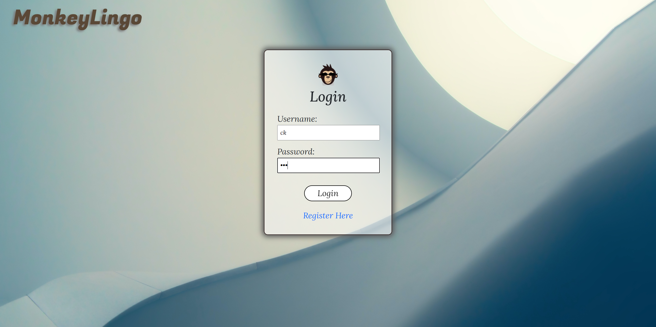
Program Feature & screenshots

Slide 10
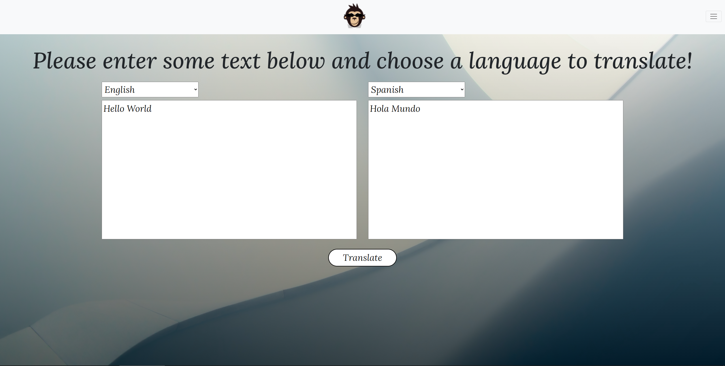
Program Feature & screenshots

Slide 11
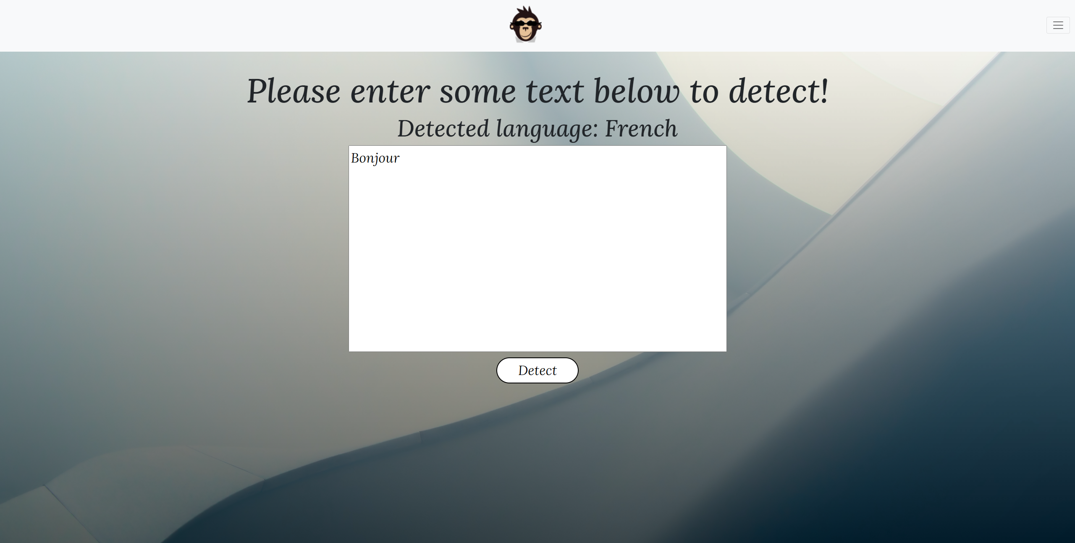
Program Feature & screenshots

Slide 12
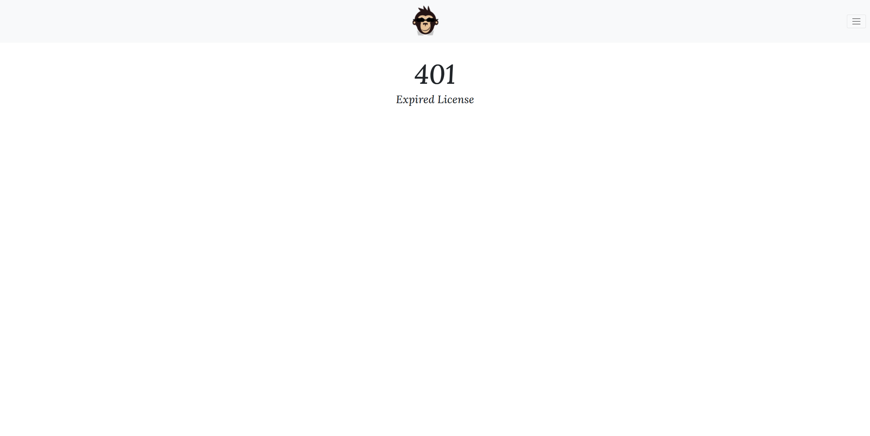
Program Feature & screenshots

Slide 13
Team Responsabilities
Mankirat:
Web Service Client API code
3rd Party API Communication (Google Translate)
Web Service Client Model
Web Service Client Controller
Login Page
About Page
Christian:
Web Service API
Web Service Controller
Web Service Model
Sign Up Page
Home Page
Together:
Web Service Database
Web Service Client Database
Translate Page
Detect Page
Styling the page (CSS)
CDN
Documentation
Client/API authorization

Slide 14
Challenges
Time management
Separation of tasks
Working with the architecture
Processing errors (debugging)

Slide 15
Learning outcomes
Implemented
Token-based authorization
Web service communication
Learned how to deal with request and response errors

Slide 16

Thank you

